Slide 1
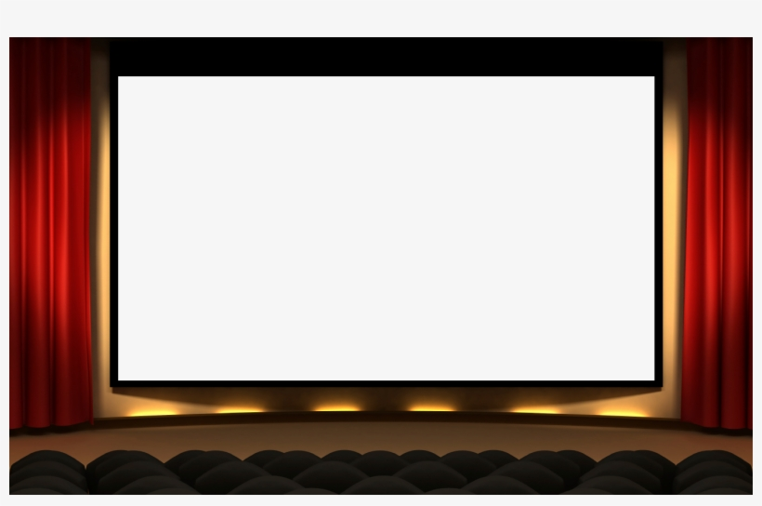
Movie Recommendation Systems
By Collin Seebeck

Slide 2
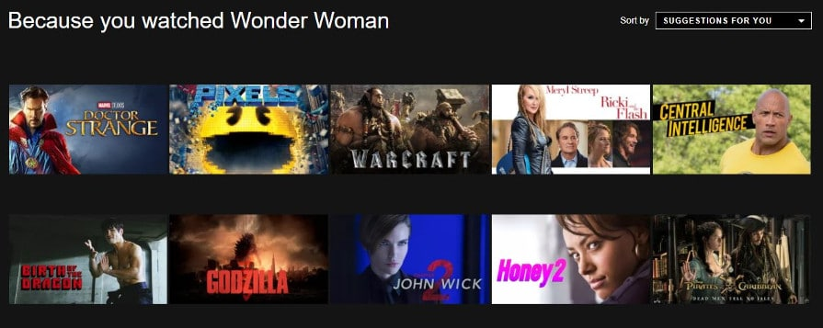
What is a Recommendation System?
A Recommendation System is software that analyzes data so that it can make predictions for things that a user might enjoy
Recommendation systems are in everything we do nowadays
A few examples of companies that use recommendation systems are Amazon, Youtube, Netflix, and even Tinder
Can you think of any other companies that use recommendation systems?

Slide 3
Types of Recommendation Systems
There are four main types of recommendation systems:
Content Based – system takes attributes of product/s that the user likes and suggests other products with similar attributes
For Example: If I go onto Amazon and buy a hammer. Amazon might suggest that I buy other hammers, screws, or wrenches because they are all tools
Collaborative Based – system groups users together based on what similar products they like and then recommends products to users based on what products other users in their group enjoyed
For Example: Let’s say you go onto Youtube for the first time and play a Beyonce song. The system will group you together with other users who also like Beyonce and recommend songs / videos that other users in this group like
The more you watch the more individualized your grouping will become
Popularity Based – recommends the most popular products
Hybrid – combination of two or more of the systems above

Slide 4
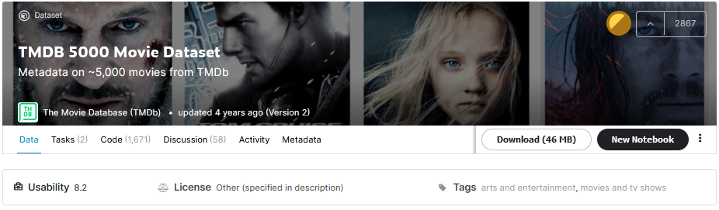
About the Data
Data Source: https://www.kaggle.com/tmdb/tmdb-movie-metadata
Two csv files (Movies and Credits)
20 columns in the Movies csv: genres, keywords, language, etc. . .
3 columns in the Credits csv: movie_id, title, cast
Data Limitations
Only about 5,000 movies in the dataset
Only goes up to 2017

Slide 5
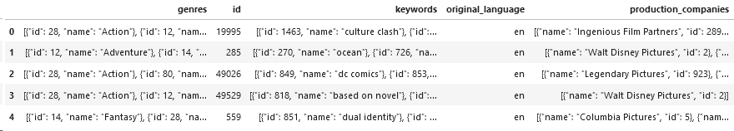
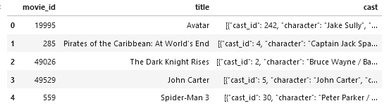
Starting Data
Movies CSV
Credits CSV

Slide 6
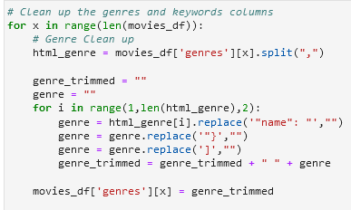
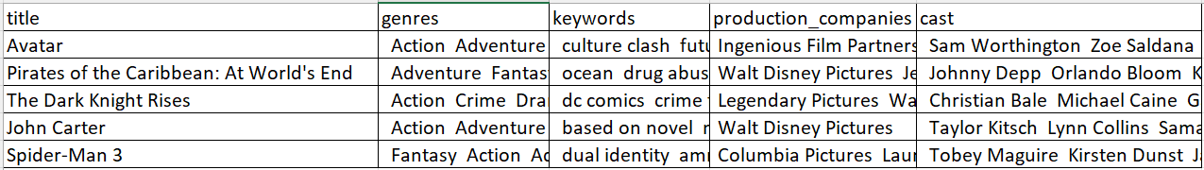
Cleaning the data
Sample Python Code
Clean Dataset

Slide 7


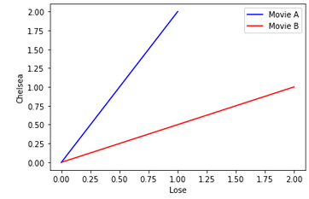

Finding Similarity 1
Import Dependencies
Finding Similarity Code
Example:
Text from Movie A: Chelsea Lose Chelsea
Text from Movie B: Lose Chelsea Lose
Using CountVectorizer.fit_transform and let's say Lose is X and Chelsea is Y it becomes
Movie A (1,2)
Movie B (2,1)
Then cosine similarity simply finds the value of cos(θ)
The smaller the angle the more similar the movies are
The smaller the angle the larger cos is. cos(0) = 1 cos(90)=0
θ

Slide 8
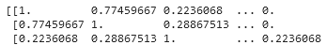
Finding Similarity 2
Cosine Similarity Matrix Example
Ran same code to generate a cosine similarity matrices for:
Keywords,
Cast, and
Production Companies
Calculating Total Cosine
θ
Let's Test Out the Model

Slide 9
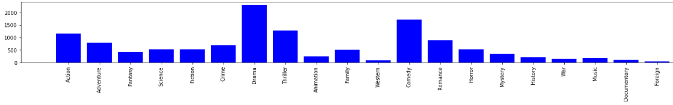
Evaluate the Model
Unsupervised Machine Learning Model
No defined right or wrong recommendation
How many of the genres from the recommended movies match the genres in the original movie
Example: Movie A genres: Action, Fantasy, and Drama
Recommended Movies based on Movie A genres: Action, Fantasy, Drama, and Thriller
This would be 3 correct and 1 incorrect
Choose not to look at any other columns because there are too many fields in other columns
θ

Slide 10
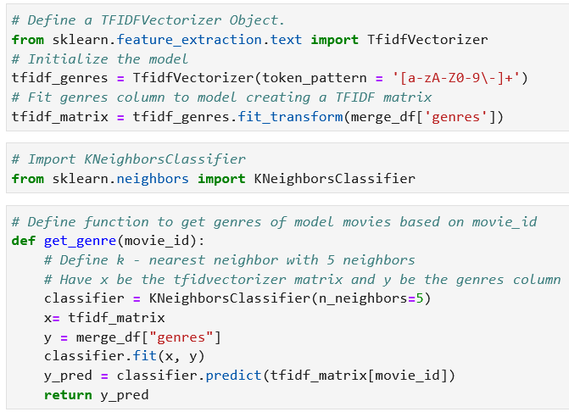
Evaluate the Model 2
Evaluate the Model 1
TF-IDF – Term Frequency Inverse Document Frequency
Term Frequency – How many times a word appears in a document
Inverse Data Frequency – how important is a word
Commonly used to transform text so that it can be used in algorithms / calculations
Used TF-IDF so that text could be used in K – Neighbors Classifier
Results
Correctly Recommended Genres: 92.3 %
Incorrectly Recommended Genres: 7.7 %
θ

Slide 11
Evaluate the Model 3
Evaluate the Model 2
θ

